Slide 1

\\\\\\\\\\\\\\\\\\\\\\\\\\\\\\\\\\\
Mobile Video Game Testing
League of Legends Wildrift
Web Application Testing
Hot Spot Coffee
Final Project
Tester: Sorin Emil Dan

Slide 2


APP DESCRIPTION
League of Legends Wildrift
Mobile Game
Online MOBA Game

Slide 3
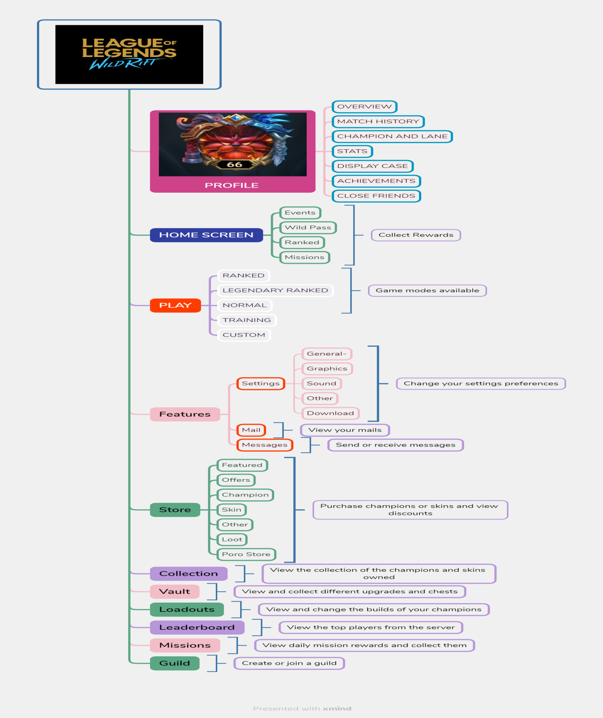
Xmind Map League of Legends Wildrift

Slide 4

TESTING APPROACH
Exploratory Testing for main functionalities;
Performance testing to test the response time on client and server and the network connectivity on mobile data and Wi-fi;
Compatibility Testing to see if the a game is working on different devices and on Android and IOS;
Visual UI testing was used to verify if the visual design, animations, gameplay and Home Screen function properly.
Register the bugs in Mantis.
Write the Smoke tests ;
Write the Test Report, Test Data Set.
Functional Testing

Slide 5

TOOLS USED
Mantis Bug Tracker – Bug Reporting
TestLink – Test Case Management
Snipping Tool and Paint – Screenshots Capture
Xmind Tool – Mind Maps

Slide 6

TESTING TYPES
Functional Testing;
Non-functional Testing
Exploratory Testing;
Smoke Testing;
Compatibility Testing;
UI Testing
Performance Testing;

Slide 7
BUGS OVERVIEW
Functionality | Defect
Home Screen | 0053444
Play | 0053443 0053583
Settings | 0053442

Slide 8
BUG DETAILS
Severity | Key | Summary
Major | 0053442 | The Network Test setting fails to load.
Normal | 0053444 | The Home Screen takes a long time to load.
Normal | 0053583 | The Replay feature for a match is unavailable.
Minor | 0053444 | The icon of champion Swain features a hexagon.

Slide 9
Improvements Overview
IMPROVEMENTS SEVERITY | NUMBER | PERCENTAGE
MAJOR | 1 | 50%
NORMAL | 1 | 50%
TOTAL | 2 | 100%

Slide 10
TEST CASES RESULTS
Executed Test Cases
Functionality | Total | Passed | Failed | Blocked | Not Run | Defects Improvement
Home Screen | 14 | 13 | 1 | 0 | 0 | 0053444
Play | 7 | 5 | 2 | 0 | 0 | 0053443 0053583
Profile | 7 | 7 | 0 | 0 | 0
Store | 2 | 2 | 0 | 0 | 0
Registration and Login | 10 | 10 | 0 | 0 | 0
Settings | 14 | 13 | 1 | 0 | 0 | 0053442 0053446
UI Testing | 1 | 1 | 0 | 0 | 0 | 0053448
Compatibility Testing | 4 | 4 | 0 | 0 | 0
Performance Testing | 3 | 3 | 0 | 0 | 0
System Integration | 1 | 1 | 0 | 0 | 0
Overall Results | 64 | 60 | 4 | 0 | 0

Slide 11

CONCLUSIONS
Smoke Test Cases were executed for the main functionalities and for most of the test cases.
Performed: 60 passed, 4 failed and 2 improvements.
A total number of 4 new bugs were identified, 1 as major, 3 were identified as normal and 2 improvements.
All bugs were identified by performing Exploratory Testing and Smoke Testing.

Slide 12
LESSONS LEARNED
Finding a buggy mobile video game was quite a challenge.
Lack of the requirements was indeed a challenge.
I practiced through writing test cases and bug reporting.
Through Exploratory Testing I learned better the functionalities of a mobile video game.
Using the online tools was great and I have learned new things.

Slide 13




Thank you!

